Slide 1
Shrinkage Methods
Cesar Acosta Ph.D.
Department of Industrial and Systems Engineering
University of Southern California

Slide 2
Shrinkage Methods
Two reasons for building Regression Models
Prediction
Understand relations between variables

Slide 3
Shrinkage Methods
As measured by
Prediction test MSE
Understand relations between variables b_{j}

Slide 4
Shrinkage Methods
                Expected value
b_{j} are random variables
                Variance
                Var(b_{j}) and model accuracy
                small Var(b_{j}) → high accuracy
                large Var(b_{j}) → small accuracy

Slide 5
Shrinkage Methods
                When are Var(b_{j}) large?
                Predictors are correlated (Multicollinearity)
                If number of predictors p is large (high dimensional data)

Slide 6
Shrinkage Methods
                How to reduce Var(b_{j}) improving model accuracy?
                Shrinkage regression models
                • Ridge regression
                • LASSO regression
                PCR models

Slide 7
Shrinkage Methods
                Shrinkage regression models
                Regression coefficients are shrunk towards 0
                Regularization

Slide 8
Shrinkage Methods
Multicollinearity
Some predictors are correlated with other predictors
Coefficients cannot be interpreted in the usual way
To identify multicollinearity find VIF of each predictor

Slide 9
Shrinkage Methods
Example: -perfect correlation-
Yhat = 7 + 6 x₁ + 12 x₂ x₁ = 4 x₂

Slide 10
Shrinkage Methods
Example: -perfect correlation-
Yhat = 7 + 6 x₁ + 12 x₂ x₁ = 4 x₂
= 7 + 5 x₁ + x₁ + 12 x₂
= 7 + 5 x₁ + 16 x₂

Slide 11
Shrinkage Methods
Example: -perfect correlation-
Yhat = 7 + 6 x₁ + 12 x₂ x₁ = 4 x₂
= 7 + 5 x₁ + x₁ + 12 x₂
= 7 + 5 x₁ + 16 x₂
How does, expected y, relates with x₁?

Slide 12
Shrinkage Methods
Example: -perfect correlation-
Yhat = 7 + 6 x₁ + 12 x₂ x₁ = 4 x₂
= 7 + 4 x₁ + 2x₁ + 12 x₂
= 7 + 4 x₁ + 20 x₂

Slide 13
Shrinkage Methods
Example: -perfect correlation-
Yhat = 7 + 6 x₁ + 12 x₂ x₁ = 4 x₂
= 7 + 5 x₁ + 16 x₂
= 7 + 4 x₁ + 20 x₂
There are 3 correct models

Slide 14
Shrinkage Methods
Example: -perfect correlation-
Yhat = 7 + 6 x₁ + 12 x₂ x₁ = 4 x₂
= 7 + 5 x₁ + 16 x₂
= 7 + 4 x₁ + 20 x₂
There are 3 correct models (actually ∞ models)
Cannot understand the relation between variables

Slide 15
Shrinkage Methods
Example: -perfect correlation-
Yhat = 7 + 6 x₁ + 12 x₂ x₁ = 4 x₂
= 7 + 5 x₁ + 16 x₂
= 7 + 4 x₁ + 20 x₂
What is Yhat when x₁ = 2 and x₂ = 8 ?

Slide 16
Shrinkage Methods
Example: -perfect correlation-
Yhat = 7 + 6 x₁ + 12 x₂ x₁ = 4 x₂
= 7 + 5 x₁ + 16 x₂
= 7 + 4 x₁ + 20 x₂
What is Yhat when x₁ = 2 and x₂ = 8 ? all models give
the same result

Slide 17
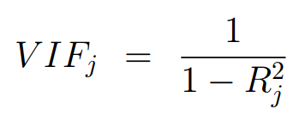

Shrinkage Methods
Variance Inflation factor (VIF)
Measures the influence of a correlated predictor on the regression model coefficients
For predictor x_{j}
where is R-squared of a regression model
with x_{j} as response variable
and predictors x₁,…x_{j-1}, x_{j+1},…x_{p}

Slide 18
Shrinkage Methods
Variance Inflation factor (VIF)
For predictor x_{j}
If x_{j} is not correlated with other predictors, VIF_{j} = 1
Rule: VIF > 10 indicates there is multicollinearity

Slide 19
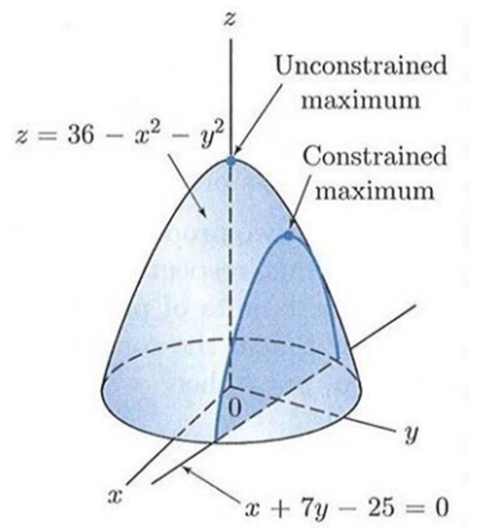
Shrinkage Methods
Types of extreme points
unconstrained
constrained

Slide 20
Shrinkage Methods
Types of extreme points
unconstrained
constrained
How to find
the constrained max?

Slide 21
Shrinkage Methods
Types of extreme points
unconstrained
constrained
How to find
the constrained max?
Lagrange multipliers

Slide 22
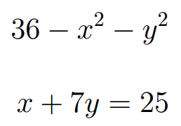
Shrinkage Methods
Example:
Max
Constrained
Optimization Problem

Slide 23

Shrinkage Methods
Example:
Max
set Lagrange function
find the –unconstrained max- of the lagrange function

Slide 24
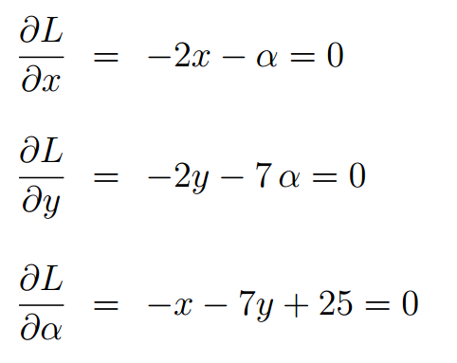
Shrinkage Methods
Example: -unconstrained max-

Slide 25
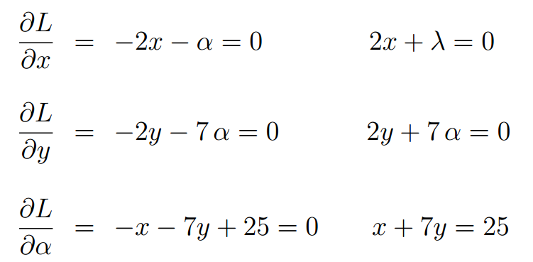
Shrinkage Methods
Example: -unconstrained max-

Slide 26
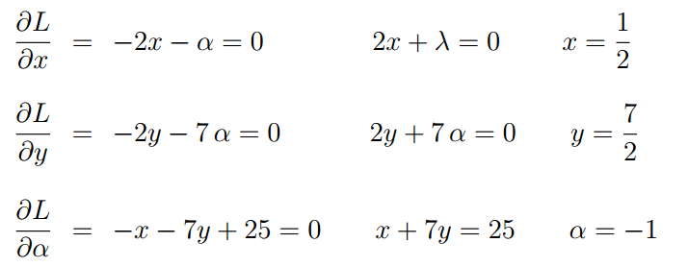
Shrinkage Methods
Example: -unconstrained max-

Slide 27
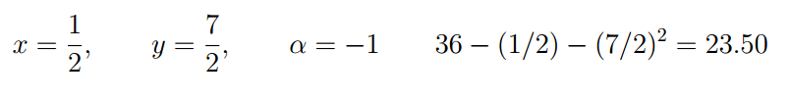
Shrinkage Methods
Example: -unconstrained max-
solution

Slide 28
Shrinkage Methods
Example: -constrained max-
23.50
use 2 lagrange multipliers
for 2 constraints

Slide 29
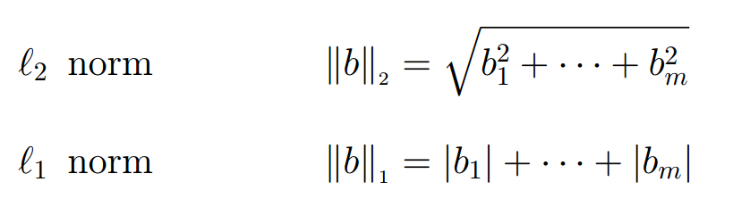
Shrinkage Methods
Norm of a vector
Vector b’ = [b₁,…,b_{m} ]

Slide 30
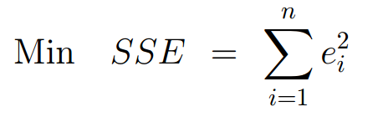
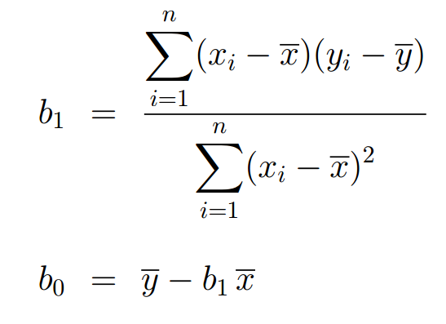
Shrinkage Methods
Linear Regression models
loss function
with solution

Slide 31

Shrinkage Methods
Linear Regression models
loss function
with solution

Slide 32
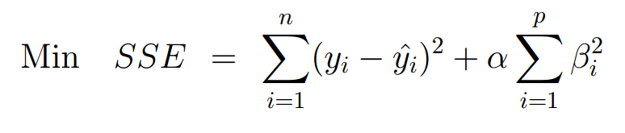
Shrinkage Methods
Ridge Regression model
loss function
This loss function prevents large regression coefficients
Second term is called shrinkage penalty
As α increases, regression coeffs. decrease, to get Min SSE

Slide 33

Shrinkage Methods
Ridge Regression model
loss function
with solution

Slide 34
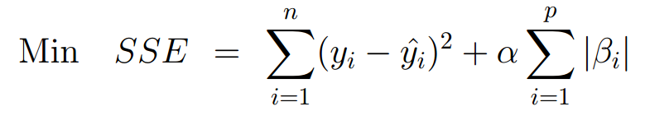
Shrinkage Methods
LASSO Regression model
loss function
This loss function prevents large regression coefficients
If α large, some regression coefficients are equal to zero
yielding a more simple regression equation

Slide 35
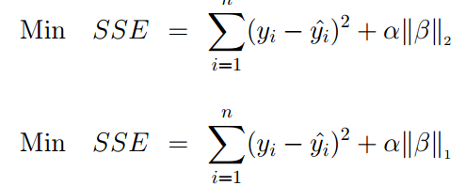
Shrinkage Methods
Ridge vs. LASSO Regression models
loss functions

Slide 36
Shrinkage Methods
Ridge vs. LASSO Regression models
loss functions
tuning parameter α value is chosen by cross validation

